Slide 1
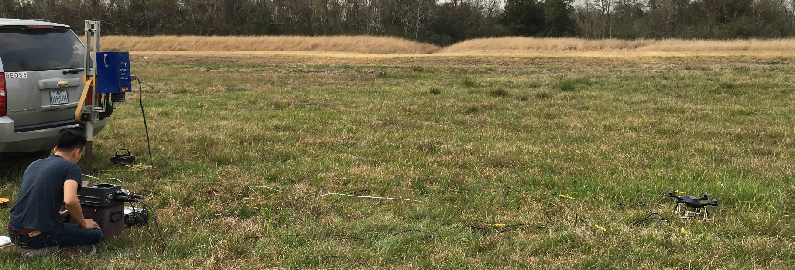
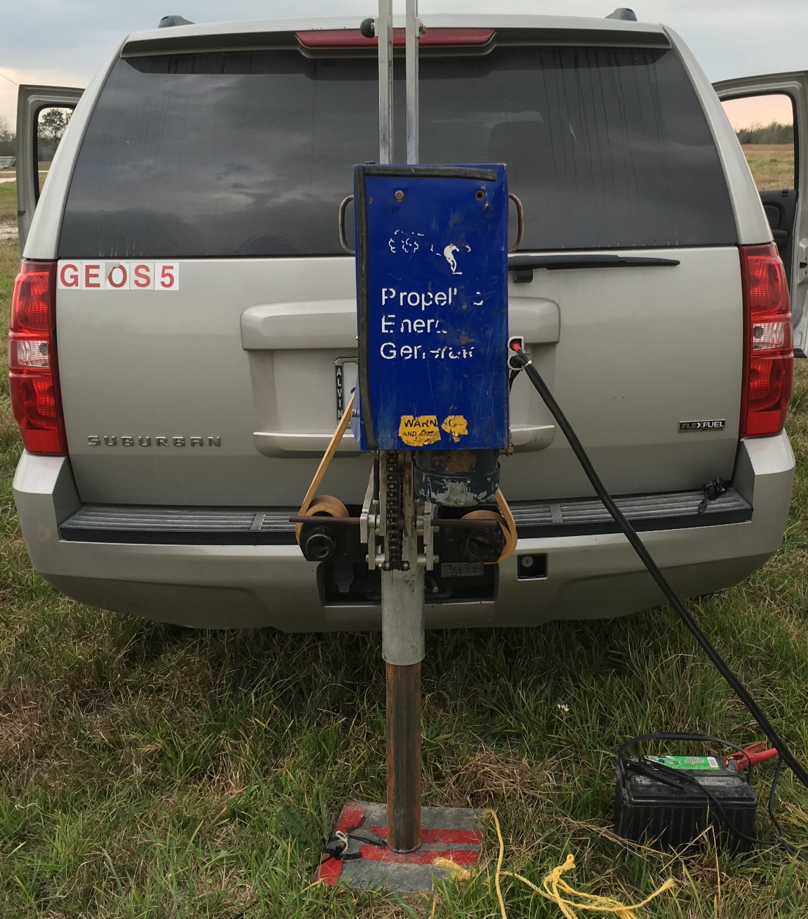
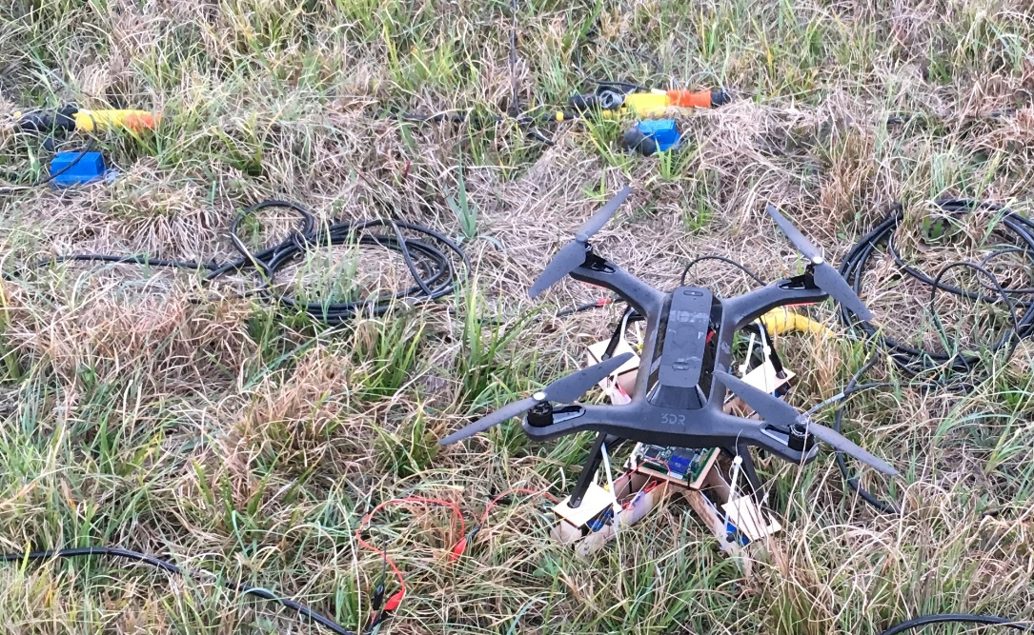
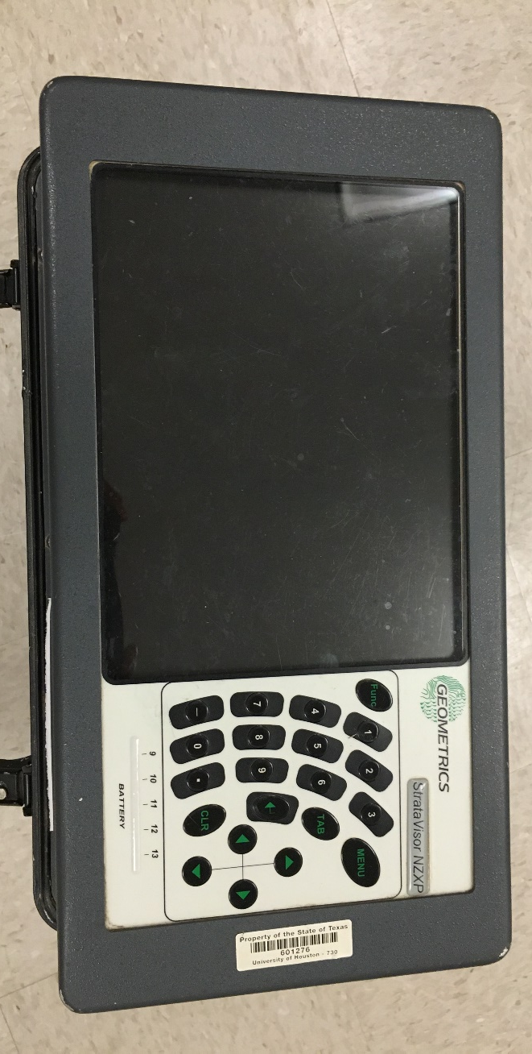
a.
b.
d.
c.
b.
Vibrating truck setup(motor + battery + piston)
c.
d.
Traditional cabled system
Vibrating plate
Seismic drone system

